Slide 1
Brand Yourself
Creating a Digital, Professional Presence
Joey Stanley
DigiLab Reasearch Assistant
joeystanley.com
September 28, 2018
DigiLab, Main Library, University of Georgia
https://xkcd.com/1827/

Slide 2

https://xkcd.com/1827/

Slide 3
Outline
social media
Academia.edu
ResearchGate
GoogleScholar
others
personal webpage
website builders
build from scratch
what to include
find your community
Twitter
other places

Slide 4
Outline
social media
Academia.edu
ResearchGate
GoogleScholar
others
personal webpage
website builders
build from scratch
what to include
find your community
Twitter
other places

Slide 5

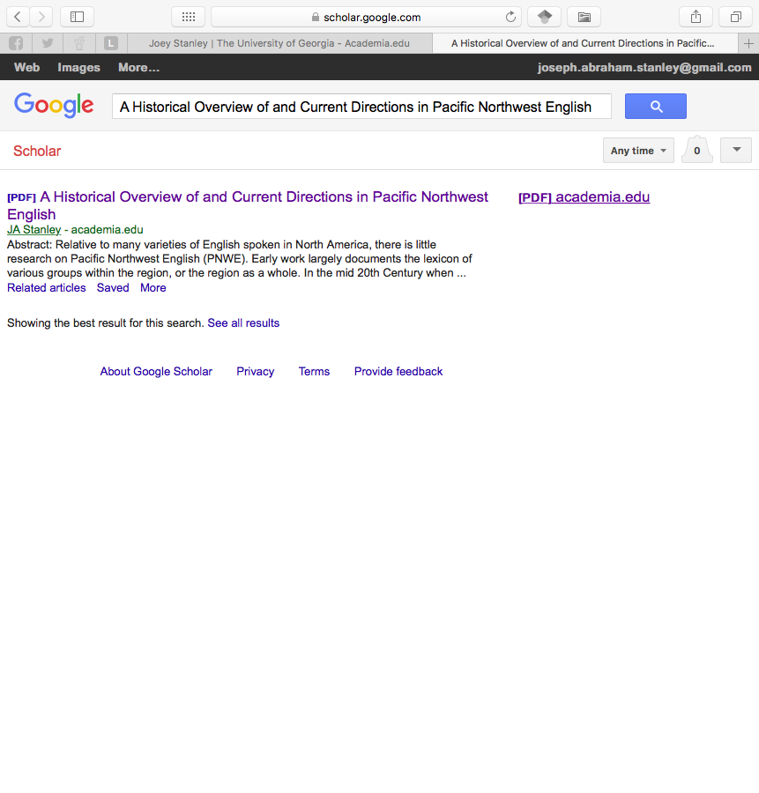
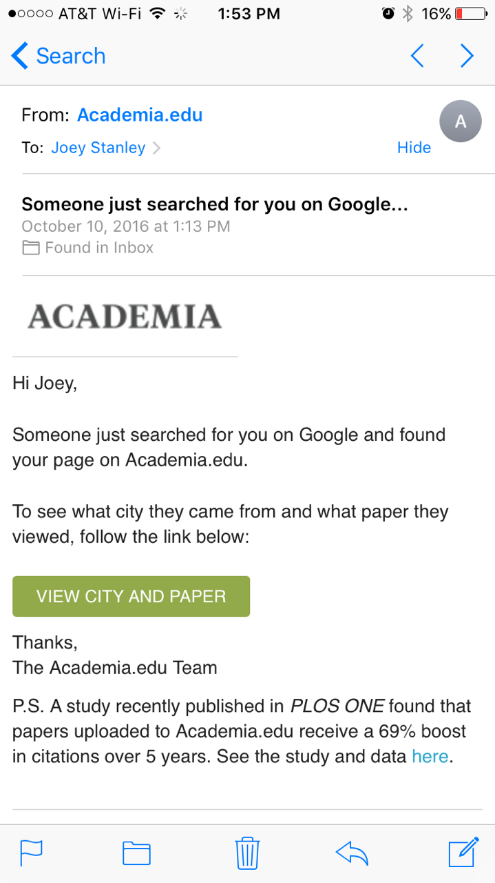
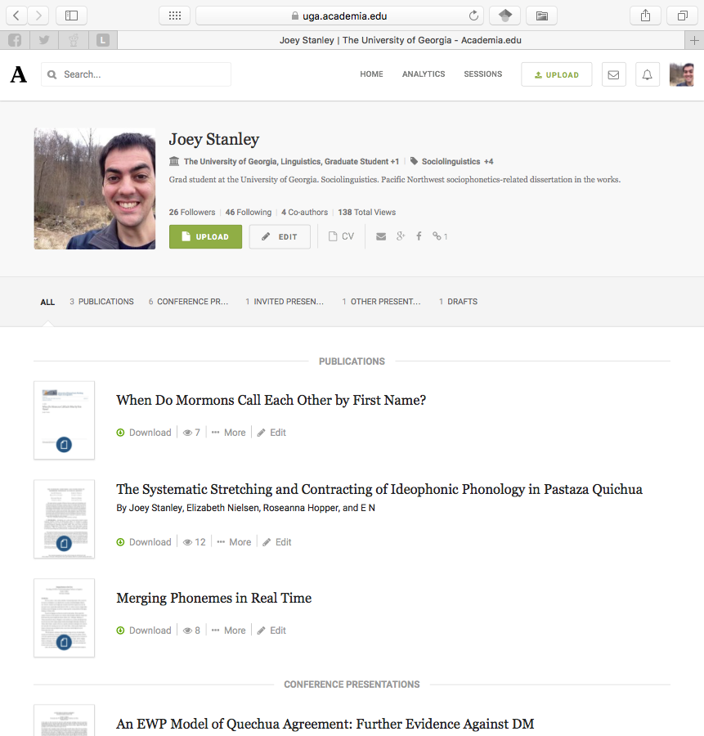
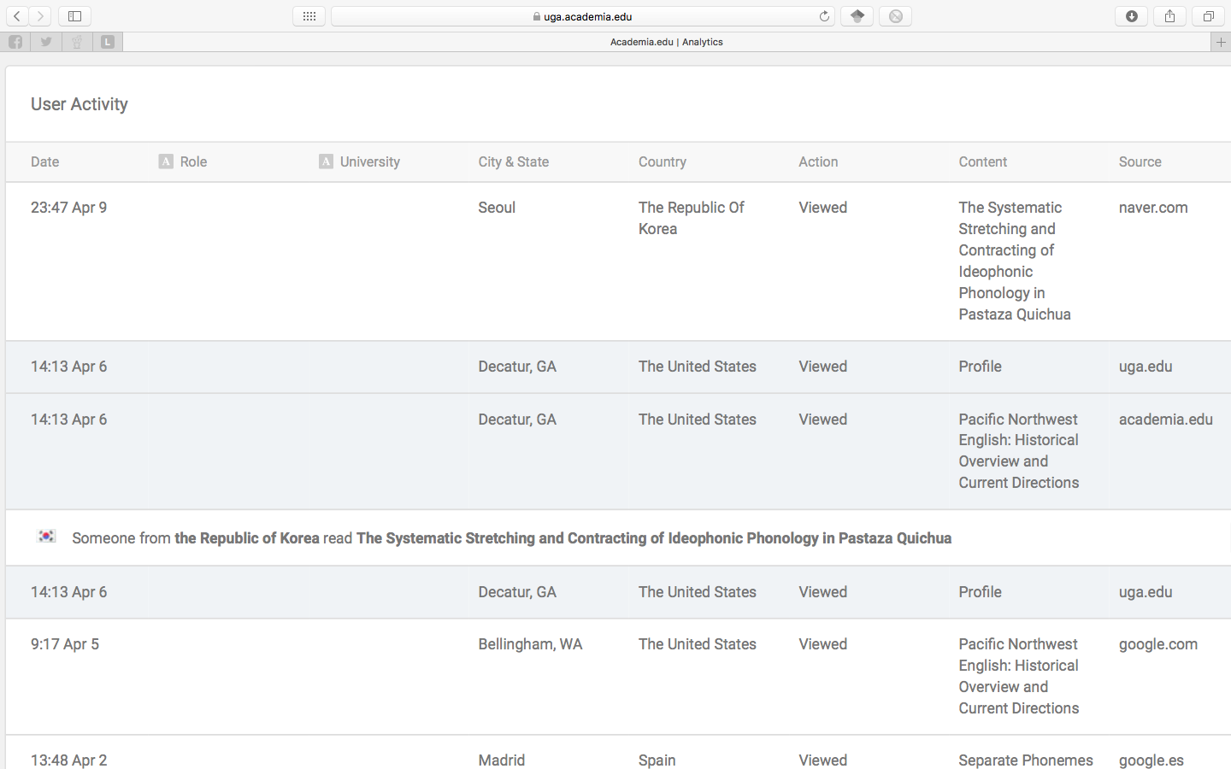
Academia.edu: Main Features
social networking site for academics
30 million users
“LinkedIn for smart people” 😉
upload your work
CV, papers, slides, posters, links
GoogleScholar picks up on it
analytics
time, paper, city, link
weekly summaries
notifications
Notes:
Get discovered

Slide 6
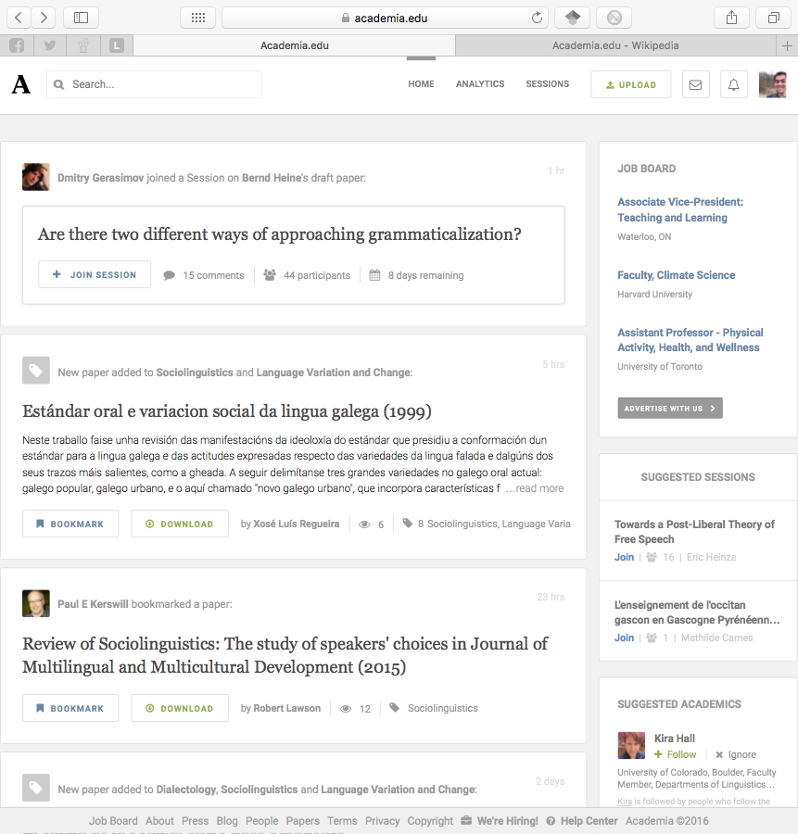
Academia.edu: Other Features
news feed
uploads
recommendations
bookmarks
session activity
suggested jobs, people, topics
Notes:
Discover others

Slide 7
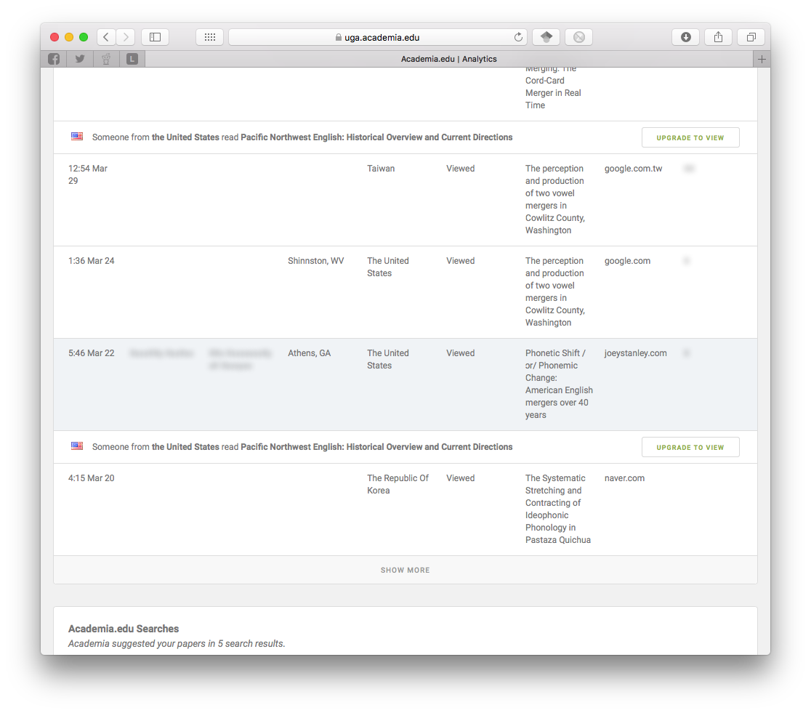
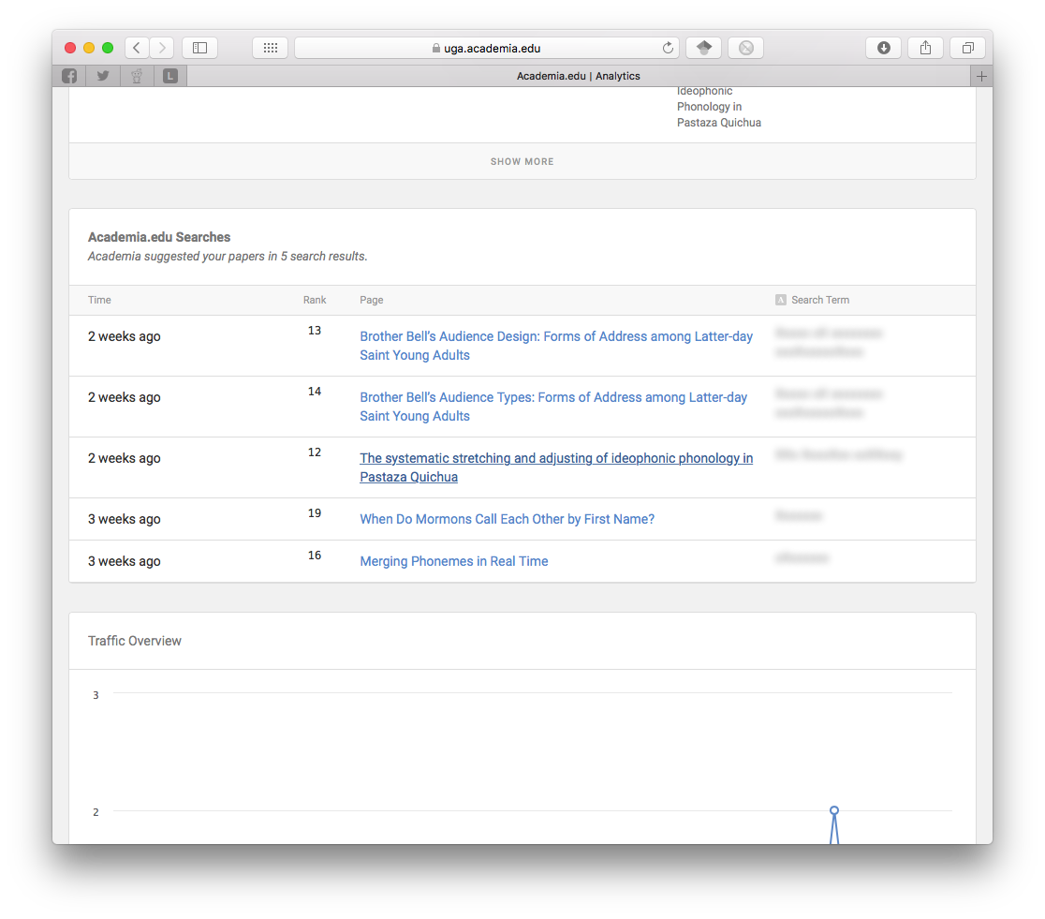
Academia.edu: Premium Features
readers
who is reading you
institution, job title
mentions
papers that cite you
advanced search
search text, keywords, filters
extra analytics
search terms
12-month impact
CV analytics
$8.25/month
Notes:
Discover others

Slide 8
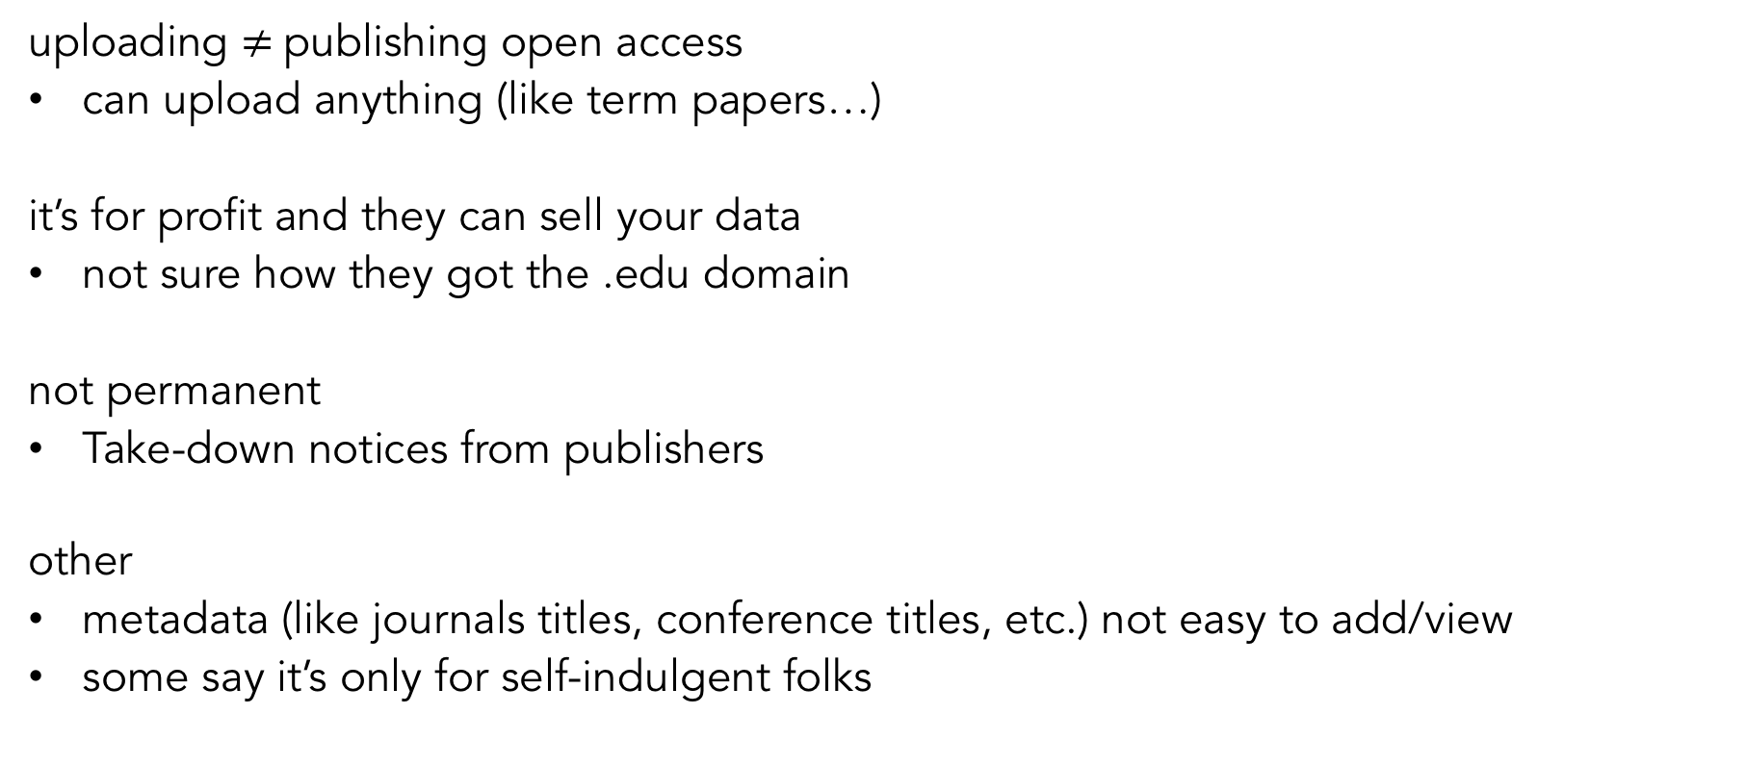
Academia.edu: Criticisms
uploading $≠$publishing open access
can upload anything (like term papers…)
it’s for profit and they can sell your data
not sure how they got the .edu domain
not permanent
Take-down notices from publishers
other
metadata (like journals titles, conference titles, etc.) not easy to add/view
some say it’s only for self-indulgent folks
Notes:
Criticisms

Slide 9
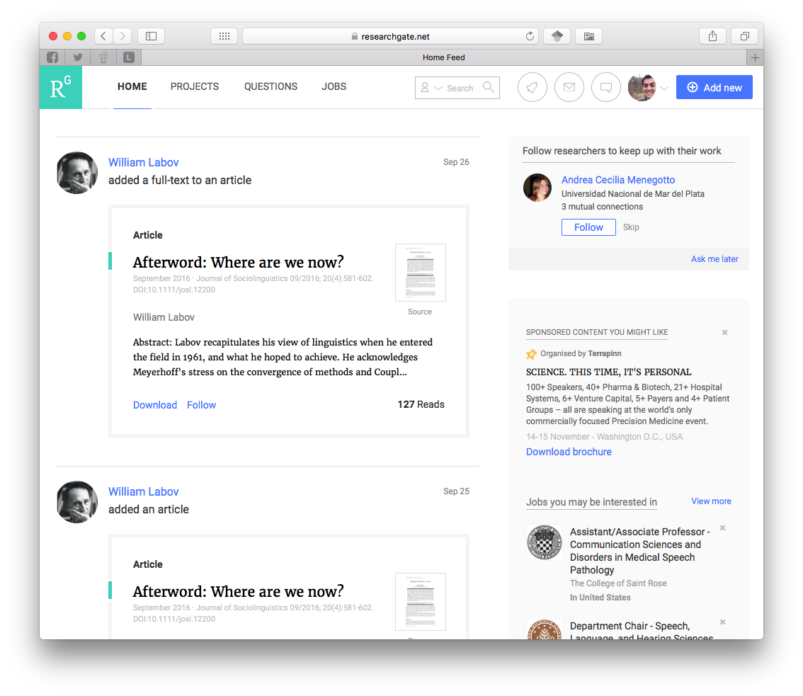
ResearchGate
social networking site for scientists
9 million users
more international
lots of overlap with Academia.edu
upload papers
follow people and interests
collaboration, feedback, commenting
networks based on citations, co-authors
more people-based

Slide 10
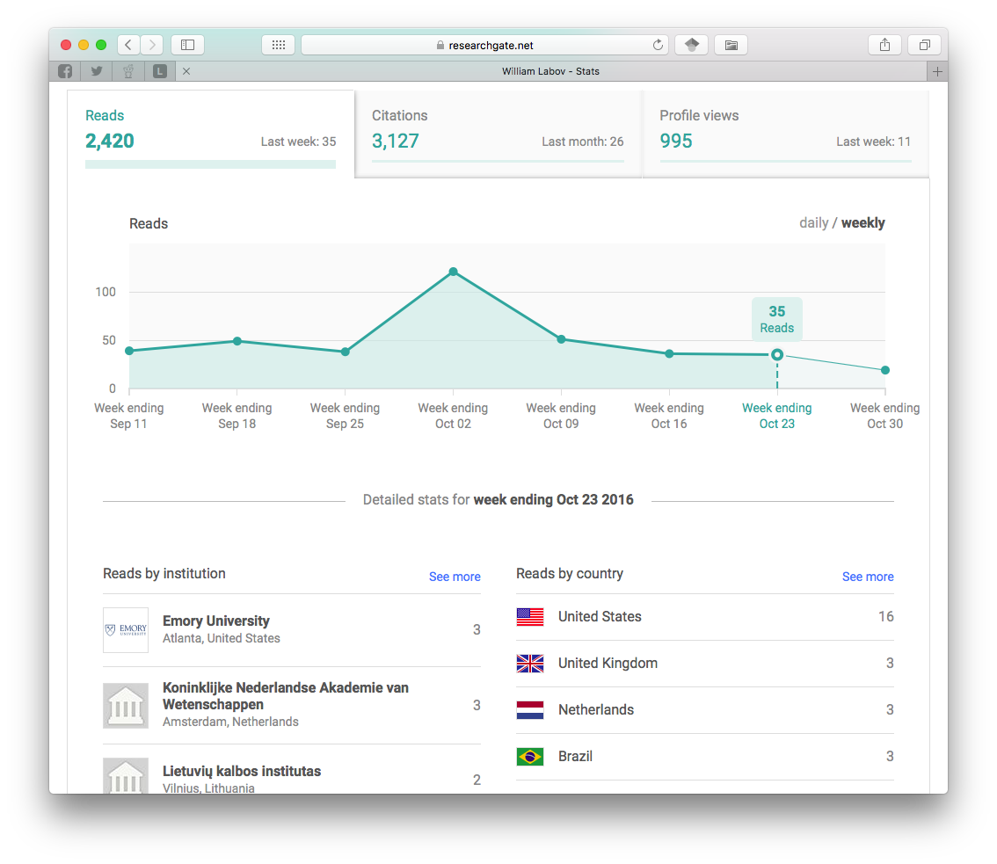
ResearchGate
analytics
similar to Academia.edu
institutions instead of cities
number of citations
criticisms
borderline spam
spam invites to your co-authors
automatically creates full-fledged accounts
questionably-inflated citation counter

Slide 11
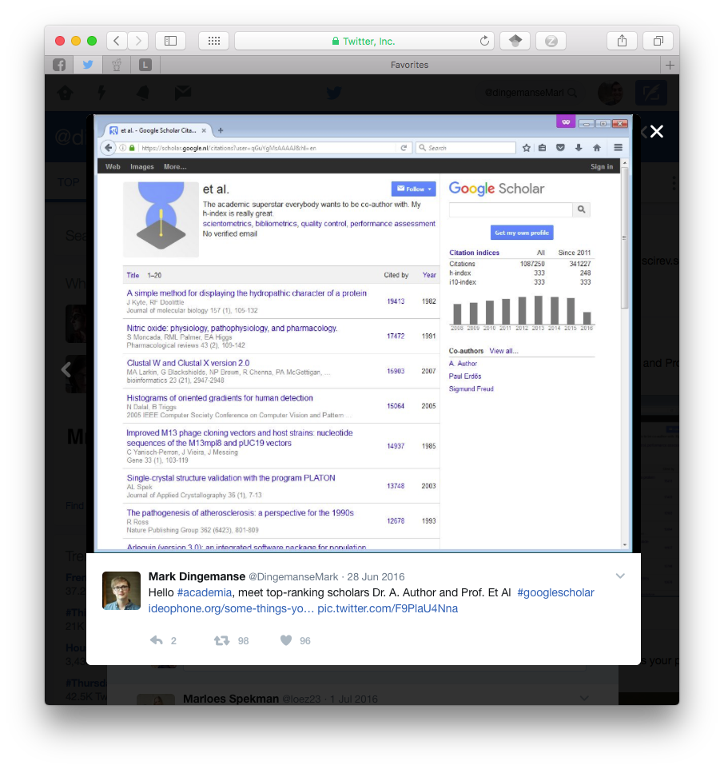
Google Scholar
live demonstration with “American English: dialects and variation”
automated
dirty data
always double check metadata
questionable citation counter
pulled from any source
easy to inflate with fake publications

Slide 12
Impact Story
a non-profit that helps scientists learn where their research is being cited, shared, saved and more
links all your other accounts together
tracks who cites, mentions, reads you
$10/month

Slide 13
Others
Mendeley
Small, but focused community
Zotero
Mostly citation management
some networking
LinkedIn
Just make a strong, low-maintenance profile

Slide 14
Share Your Work
Data repositories
Code
Slideshows

Slide 15
Profile Fatigue
many profiles to maintain
information silos
can’t easily get info back from them
sites don’t talk to each other
possible solution
Pick one to be your main page
Put a full profile there
Create digest version on other pages
Redirect people to your main one.

Slide 16
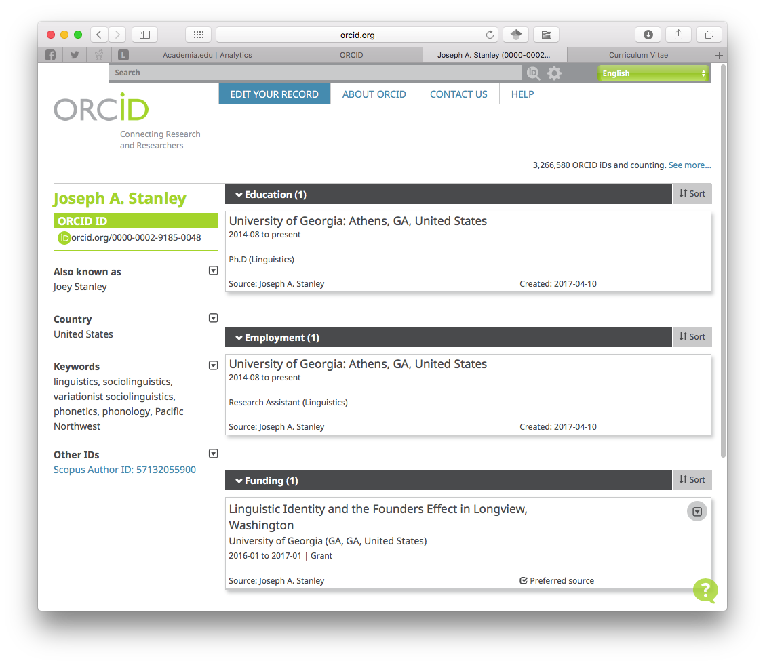
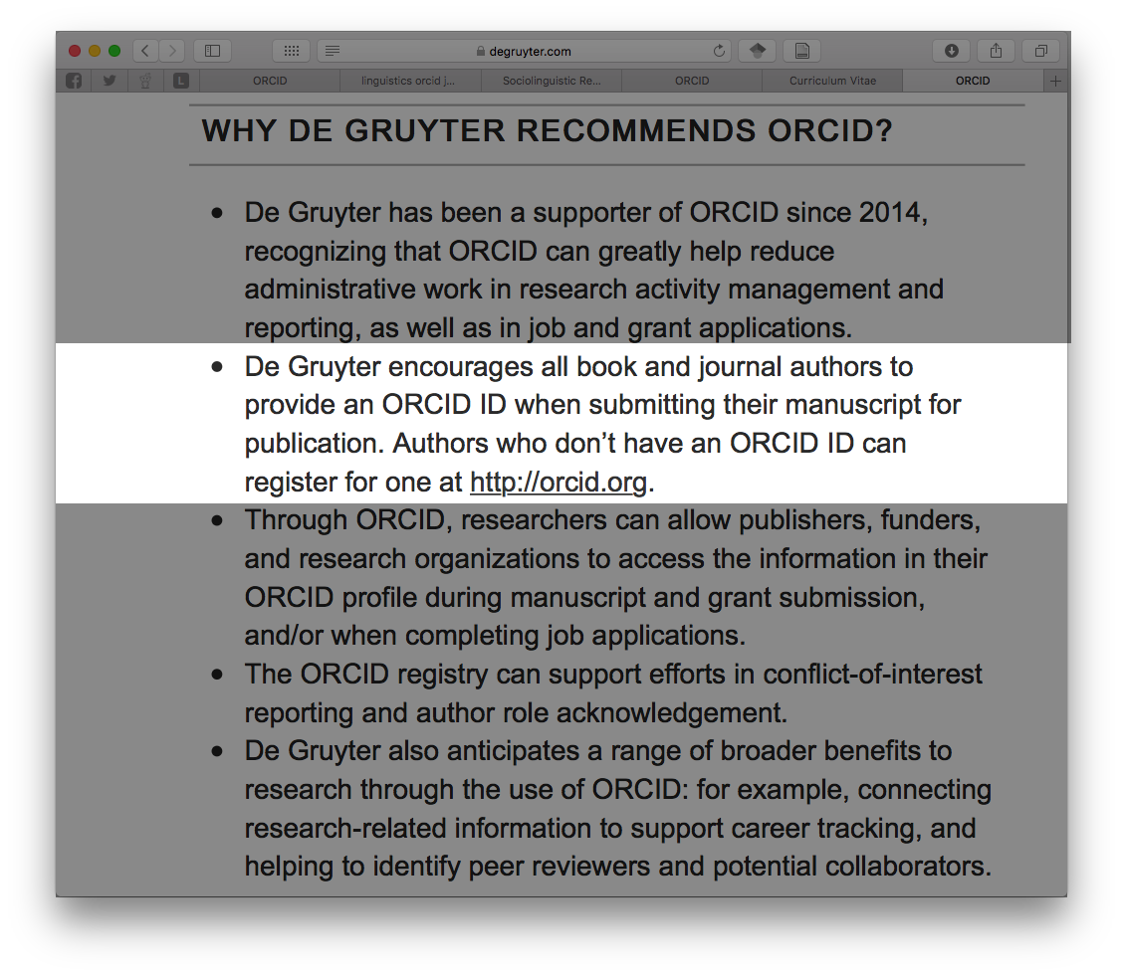
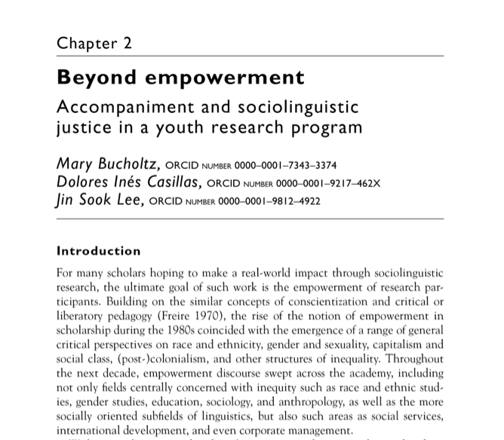
Orcid
permanent identifiers for researchers
orcid.org/0000-0002-9185-0048
help people know it’s you
similar name in your field
common last name
changed name
some sites connect with your ORCID record

Slide 17
Outline
social media
Academia.edu
ResearchGate
GoogleScholar
others
personal webpage
website builders
build from scratch
what to include
find your community
Twitter
other places

Slide 18
Outline
social media
Academia.edu
ResearchGate
GoogleScholar
others
personal webpage
website builders
build from scratch
what to include
find your community
Twitter
other places

Slide 19
General Information
servers and hosting
cost (in money and/or skills)
formatting, themes, design
googleability (”SEO”)
don’t rely on a UGA-hosted webpage
little control over content, appearance
can’t host PDFs and other files
can sometimes change without warning
a domain name costs money
but only (as little as) $10/year
domains.google.com
go from somesite.com/yourname to yourname.com
each website has pros and cons
www.websitebuilderexpert.com/

Slide 20


Website Builders
Square Space
stunning themes (~40)
interchangeable
mobile friendly
drag-and-drop
built-in blogging
e.g. Taylor Jones
$10+/month
WordPress
good themes
primarily blogging
other pages possible
less aesthetics control
slightly more work
e.g. Rochelle Terman
free
Wix
most popular
500+ themes
stuck with one look
not mobile-friendly out-of-the-box
Wix template
“free”

Slide 21
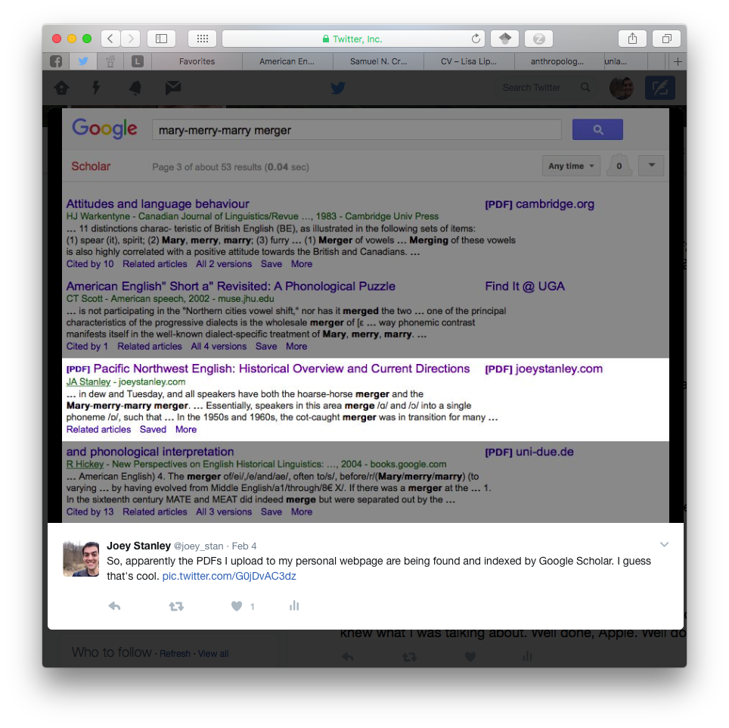
Build from Scratch
Github pages
need to be a bit tech-savvy
Jekyll, CSS, Markdown
complete control
not as easily googleable
Sravana Reddy
Ahmed Mostafa
Kieran Healy (gold standard, IMO)
free
Resources for learning how
programminghistorian.org
Lessons: Building Static Sites with Jekyll Github Pages
Lynda.com (free through UGA!)
Jekyll for Web Designers (4½ hours)
CSS: Core Concepts (9 hours)
CSS: Page Layours (9 hours)
www.codecademy.com

Slide 22
What to Include?
essential components
short bio
recent photo
interests
teaching materials
contact
brief CV (and PDF of full CV)
optional material
full CV
personal interests/hobbies
blog
shameless self-promotion
works in progress (not final results yet)
commenting on others’ work
community outreach
event promotion
explain your work to laypeople
consider buying a domain name

Slide 23
Google Analytics
tracks everything you’d ever want
takes some computer know-how
live demonstration (and shameless self-promotion…)

Slide 24
Outline
social media
Academia.edu
ResearchGate
GoogleScholar
others
personal webpage
website builders
build from scratch
what to include
find your community
Twitter
other places

Slide 25
Outline
social media
Academia.edu
ResearchGate
GoogleScholar
others
personal webpage
website builders
build from scratch
what to include
find your community
Twitter
other places

Slide 26
Other Hidden Places
could be anywhere
listservs
coffee breaks at conferences
Slack, Reddit, Twitter
ask your advisor where this communication happens
Notes:
digital humanities
Slavic and East European Languages and Literatures List
SOCNET: The Social Networks Listserv

Slide 27
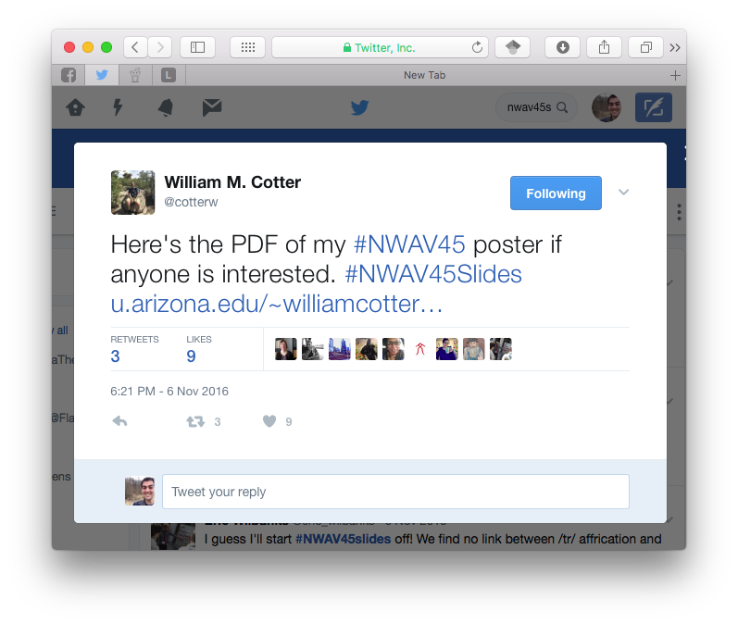
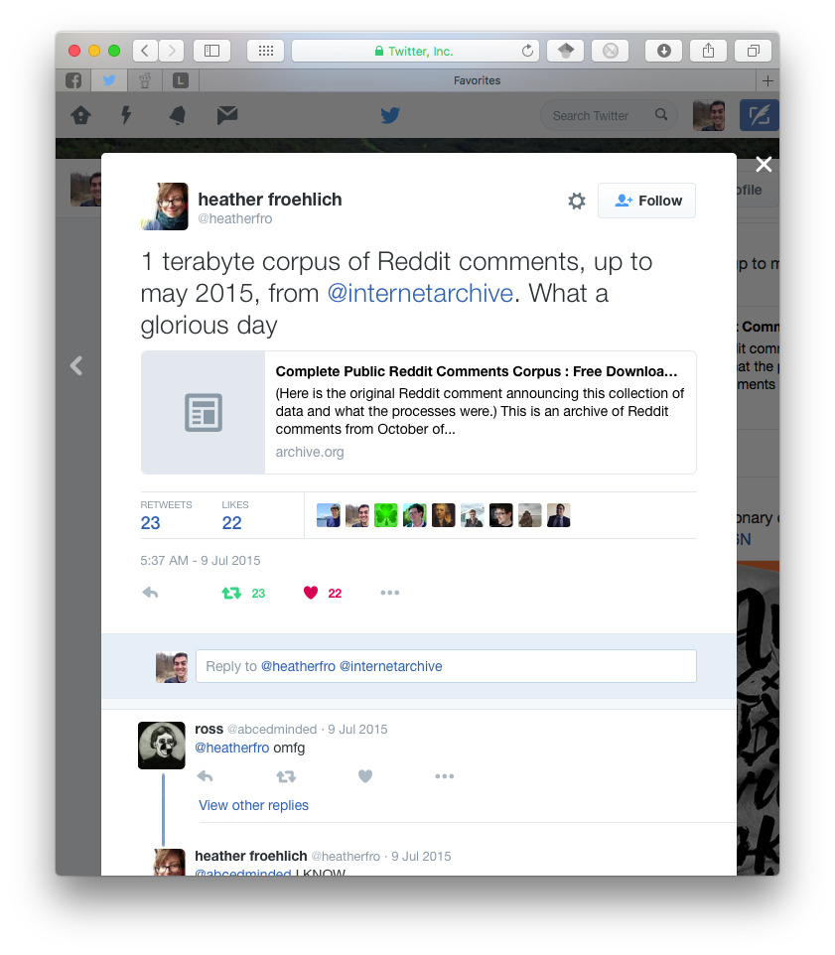
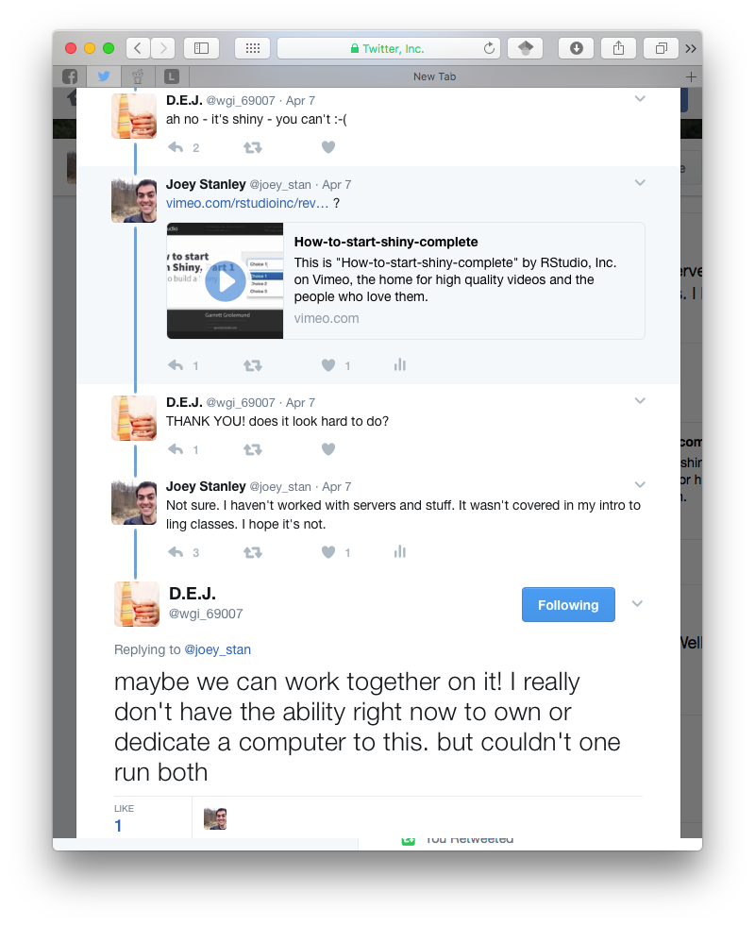
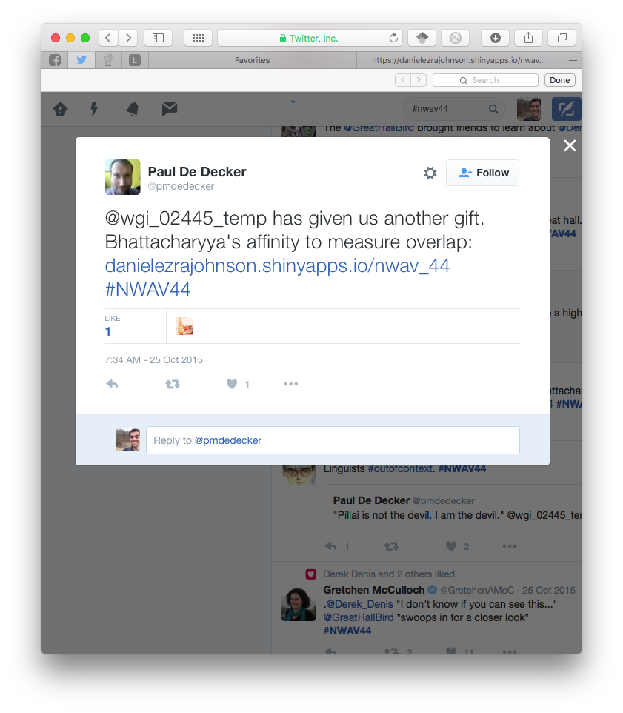
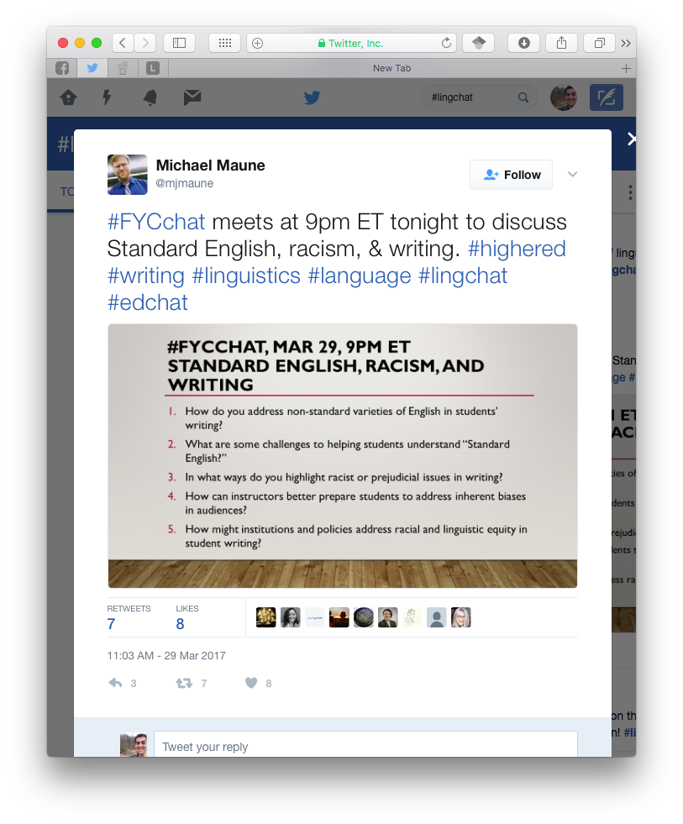
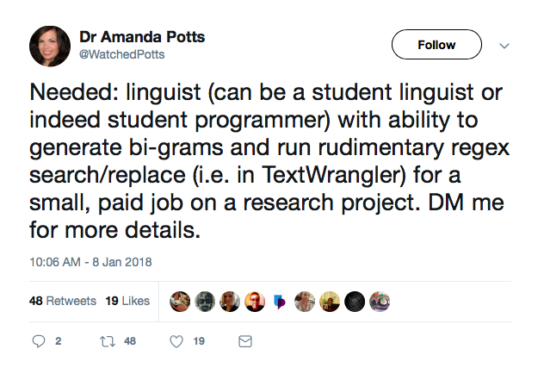
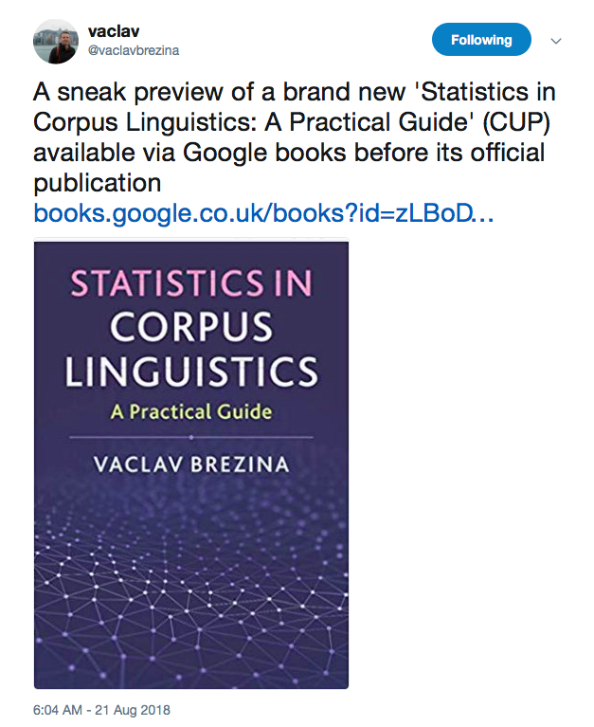
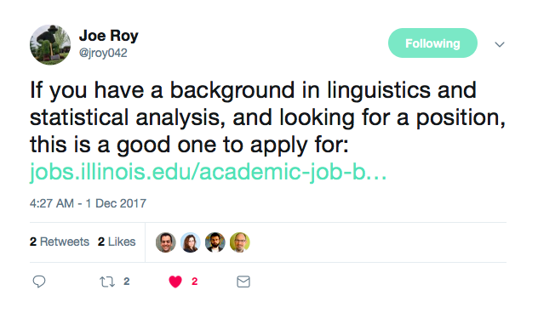
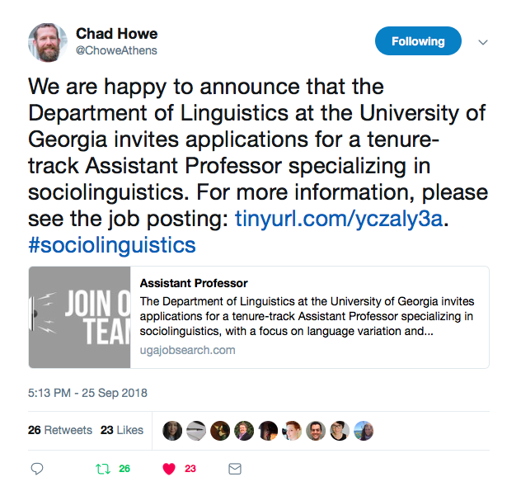
Twitter
say what you want, but Twitter is useful
job announcements
collaboration opportunities
book announcements
datasets
slides, handouts
fun conversations
other cool stuff

Slide 28
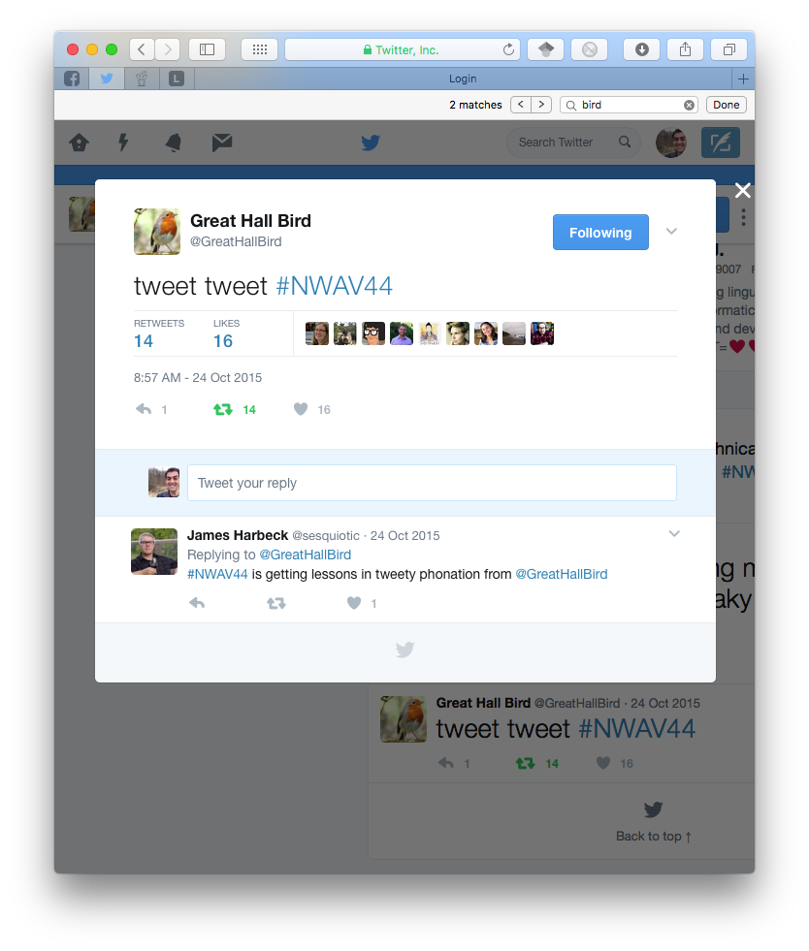
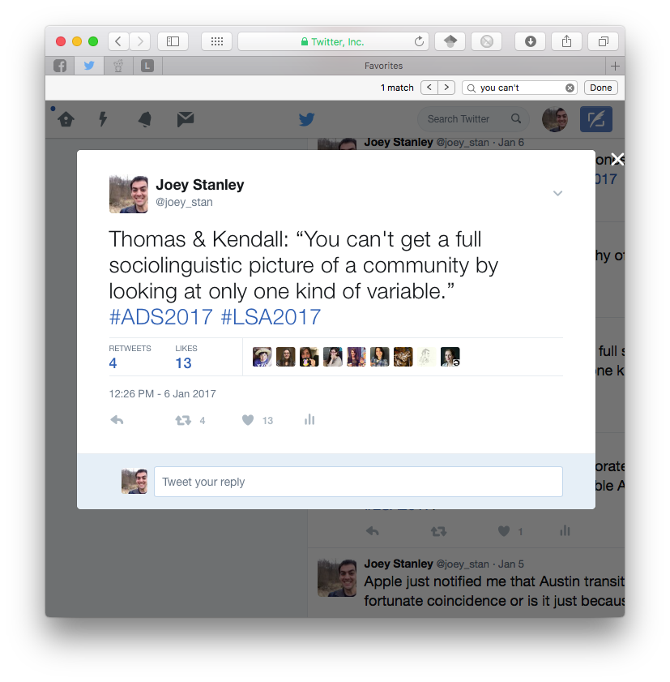
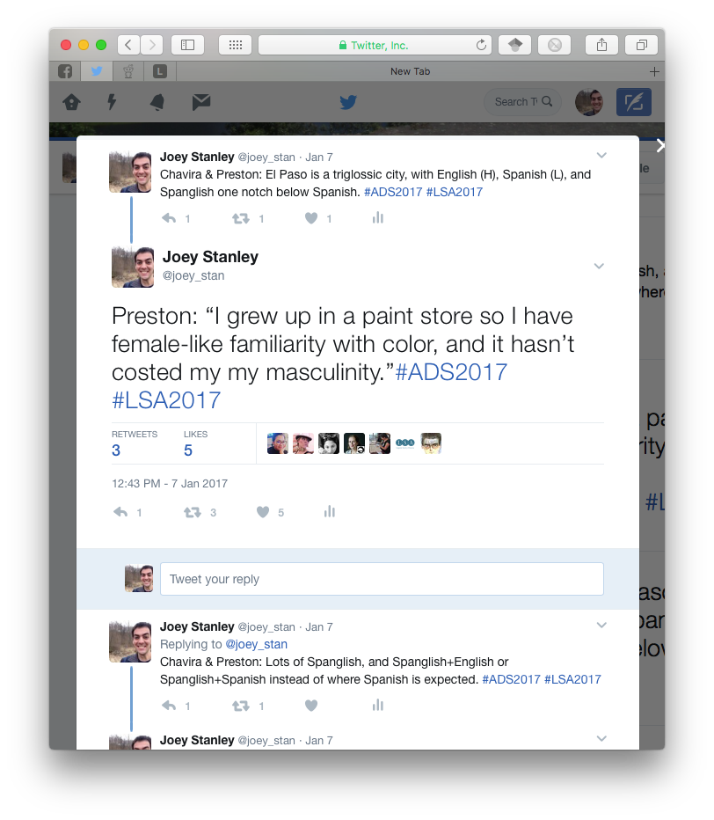
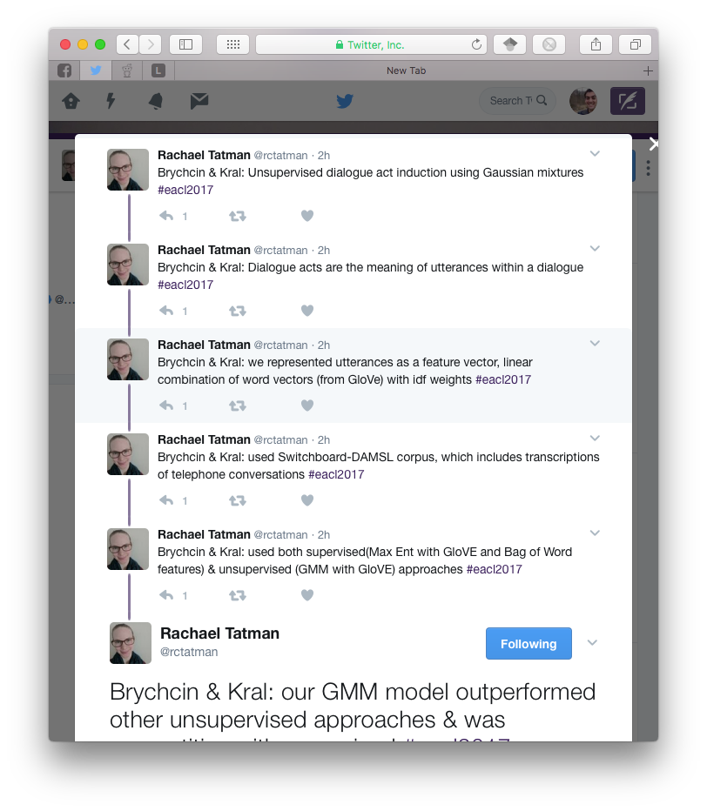
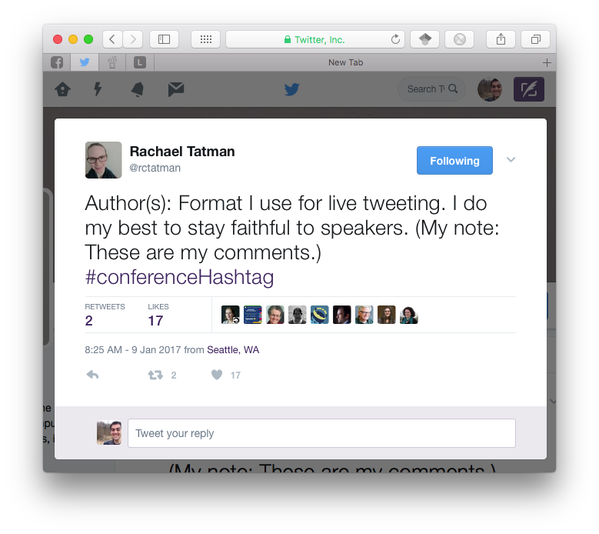
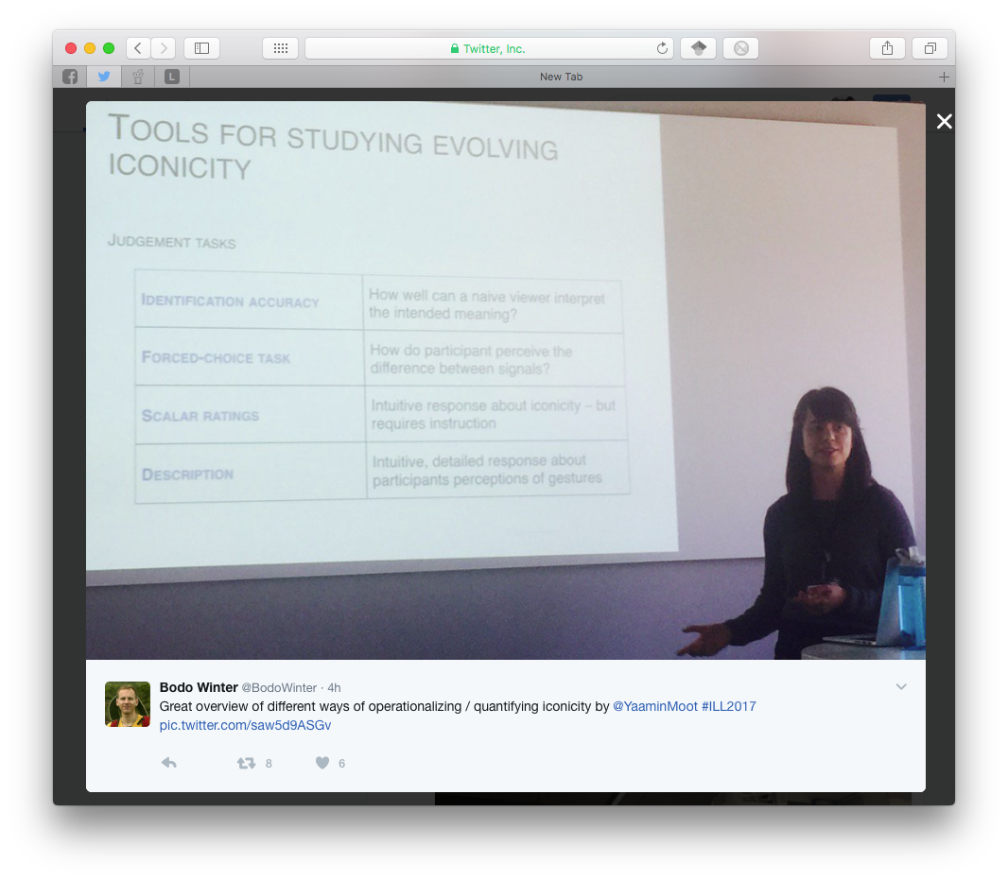
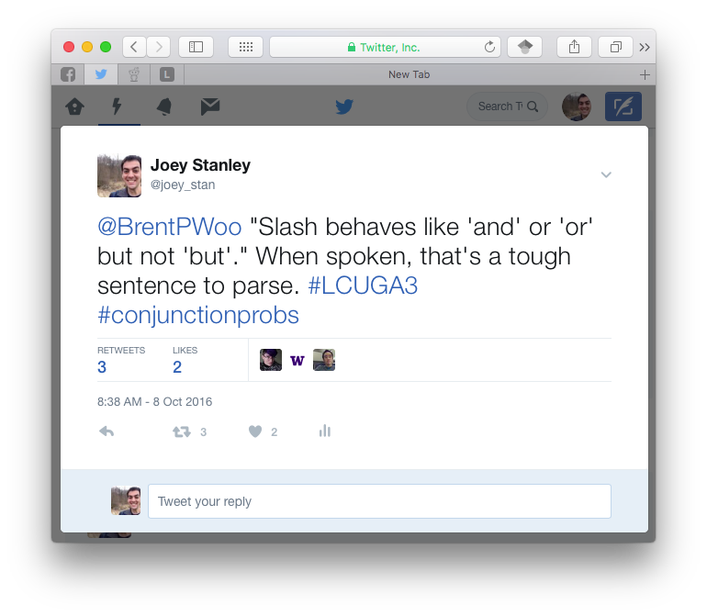
Live Tweeting Conferences
Sounds lame, but it’s actually awesome
spread info and your name
follow conferences you can’t attend
inside jokes and side conversations
what to say?
find and use the conference hashtag
up next, results, photos of charts, anecdotes, cool quotes
your own commentary (make it clear though)
Resources
https://rctatman.github.io/Livetweeting-Guide/
http://www.southernfriedscience.com/how-to-live-tweet-a-conference-a-guide-for-conference-organizers-and-twitter-users/

Slide 29
Outline
social media
Academia.edu
ResearchGate
GoogleScholar
others
personal webpage
website builders
build from scratch
what to include
find your community
Twitter
other places

Slide 30
Summary
social media
Academia.edu
ResearchGate
GoogleScholar
others
Todo:
look at what others your field are doing
consider your moral issues
find a homebase and link other sites to that
personal webpage
website builders
build from scratch
what to include
computer skills
time investment
find your community
Twitter
other places
ask around for the secret niches
contribute
twitter

Slide 31
Credits
ImpactStory’s 30-Day Impact Challenge
series of blog posts
available as a (200+ page) pdf
http://blog.impactstory.org/research-impact-challenge-ebook/
very thorough and detailed
highly recommended

Slide 32
Make something new. Now. Seriously. Go.
Social Media
Academia.edu
ResearchGate.net
scholar.google.com
ImpactStory.org
http://blog.impactstory.org/research-impact-challenge-ebook/
twitter.com
http://www.southernfriedscience.com/how-to-live-tweet-a-conference-a-guide-for-conference-organizers-and-twitter-users/
https://rctatman.github.io/Livetweeting-Guide/
Websites
SquareSpace.com
WordPress.com
Wix.com
pages.github.com
analytics.google.com
domains.google.com
Orcid.org
Resources
WebsiteBuilderExpert.com
programminghistorian.org
http://programminghistorian.org/lessons/building-static-sites-with-jekyll-github-pages
Lynda.com
https://www.lynda.com/Jekyll-tutorials/Jekyll-Web-Designers/383124-2.html
https://www.lynda.com/Web-Interactive-CSS-tutorials/CSS-Core-Concepts/80435-2.html
https://www.lynda.com/Web-Interactive-CSS-training/CSS-Page-Layouts/86003-2.html
www.codecademy.com
These slides available at joeystanley.com/brand-yourself
Feedback survey at joeystanley.com/feedback

